Slide 1
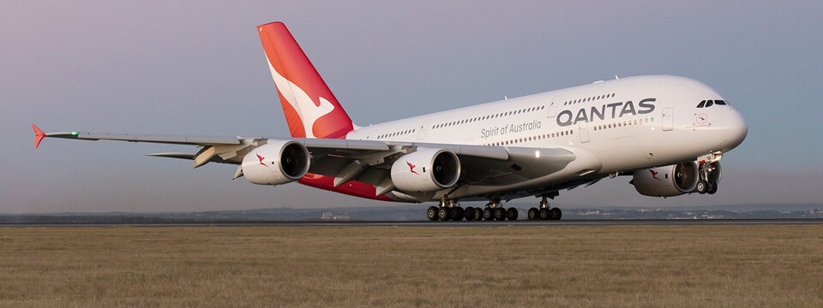

Foreign Object Debris Detection on Runways using Artificial Intelligence
[1]
Name: Rory Blair
ID: n10773398

Slide 2
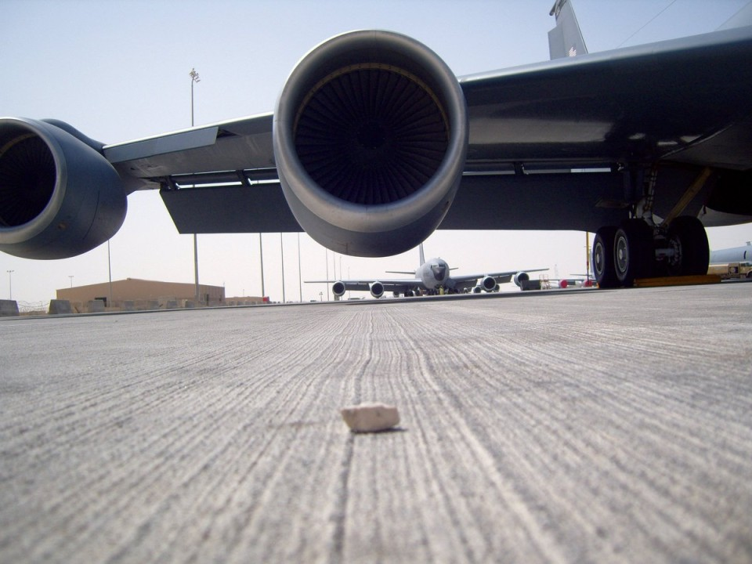
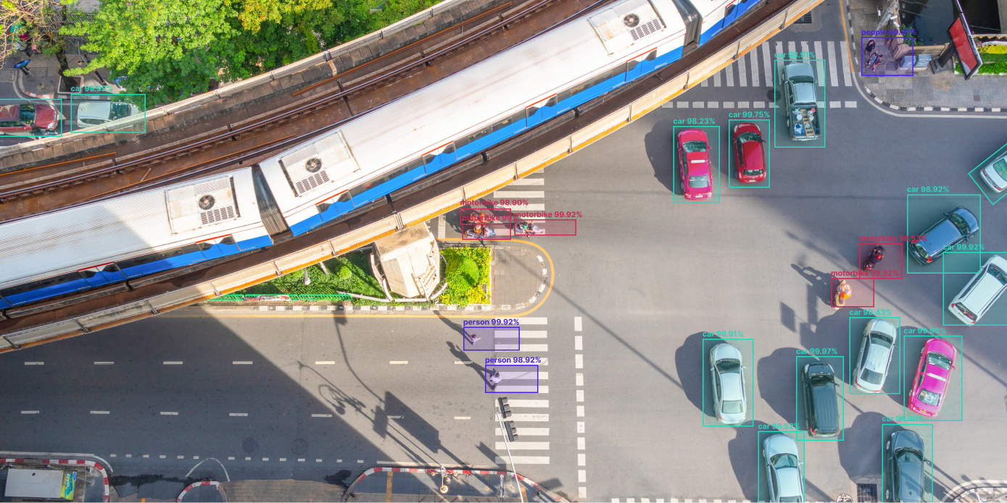
Introduction
Foreign Object Debris (FOD):
  An object that is in a location that may result in damage to a vehicle (aircraft) or a human.
  In 2008, FOD causes airlines per airport per year a cost of around USD 20 Million [4].
  Methods to mitigate FOD incidents, like visual checks and sweepers, involve human interaction that can put assessors at risk.
Artificial Intelligence (AI):
  AI models now have the capability to identify anomalies within images and videos.
Research Problem:
  The problem is although there is an implemented design, it doesn’t require verification from humans before a team is sent to the runway for inspection.
Research Question:
  Is AI alone sufficient when it comes to FOD detection on runways?
[2]
[3]

Slide 3
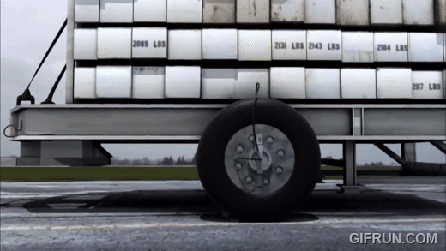
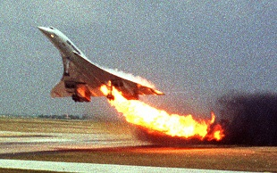
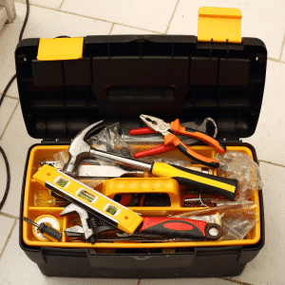
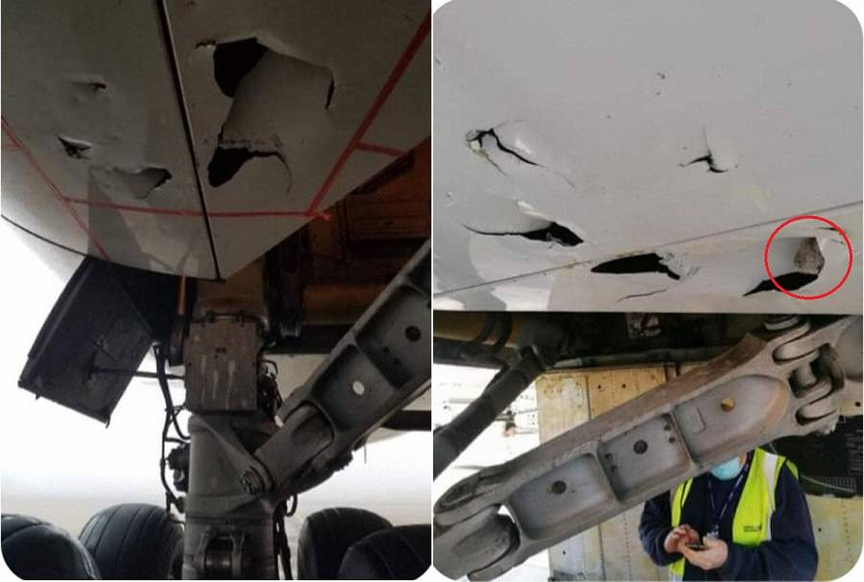
[6]
Rationale
[5]
Incident caused by FOD on runways:
  Air France 4590 (Concorde) in 2000 (Top example)
  Singapore Airlines 747-400 freighter in 2021 (Bottom example)
Possible Incident caused by FOD on runways, all of which can be fatal.
  Engine damage/failure can cause unsafe flight conditions.
  Tire damage/blow out can cause unsafe landing and take-off conditions, causing runway overruns.
  Structural damage that can cause damage to fuel tanks, hydraulic, electrical and mechanical system.
  Aerodynamic damage that can affect aircraft performance.
Many studies for FOD detection using Unmanned Aerial Vehicles (UAV) have been conducted:
  UAV and AI Application for Runway Foreign Object Debris (FOD) Detection [9]
  Live Detection of Foreign Object Debris on Runways Detection using Drones and AI [10]
[7]
[8]

Slide 4
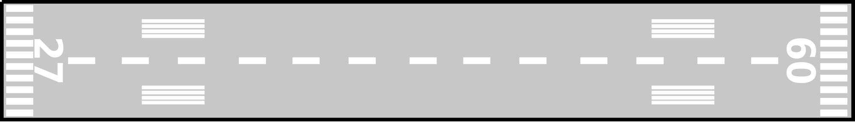

Methods
Different ways of monitoring the runways
  Moving UAV: One or Two UAVs using transmitters from UAV to tower.
  Stationary Cameras: Many cameras setup along a runway using Fibre optic wires for transmission.
Runway conditions/weather
  Sunny: Reflective surfaces
  Overcast: Shaded areas
  Windy: Effect on UAVs
  Rain: Effect on camera
FOD objects, size and positioning
  Material: Wood, Metal, Plastic
  Size: 10mm to 1000mm
  Positioning: Clustered or Spread out
AI Models
  Multiple studies performed consider the Microsoft Azure Custom Vision the best AI Model for object detection [9] [10]
[11]

Slide 5
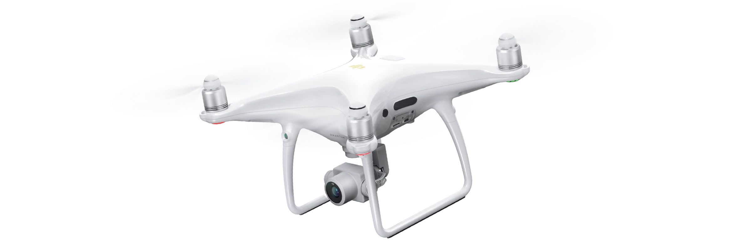
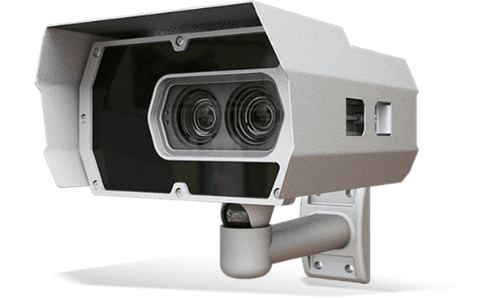
Resources
UAVs: [12]
  DJI Spark
  DJI Phantom 4 Pro (Seen on the right)
  DJI Mavic Pro 2
Cameras: [14]
  Earth Networks: HD Pan-Tilt-Zoom
  Adaptive Recognition: Vidar (Seen on the right)
  LATECOERE: Airport Camera
Test beds:
  Car park
  Runway
Objects:
  Metal: Nut, bolts, screws, strips, sheets
  Plastic: bottles, bucket
  Wood: planks
AI Model: Microsoft Azure Custom Vision
[13]
[15]

Slide 6
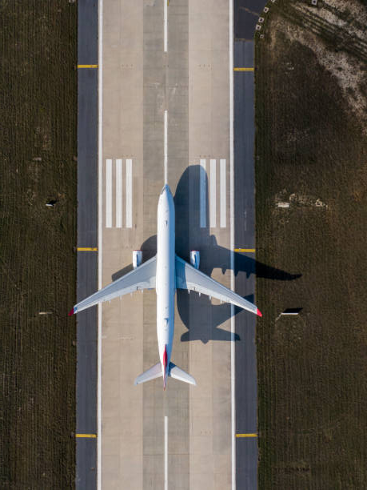
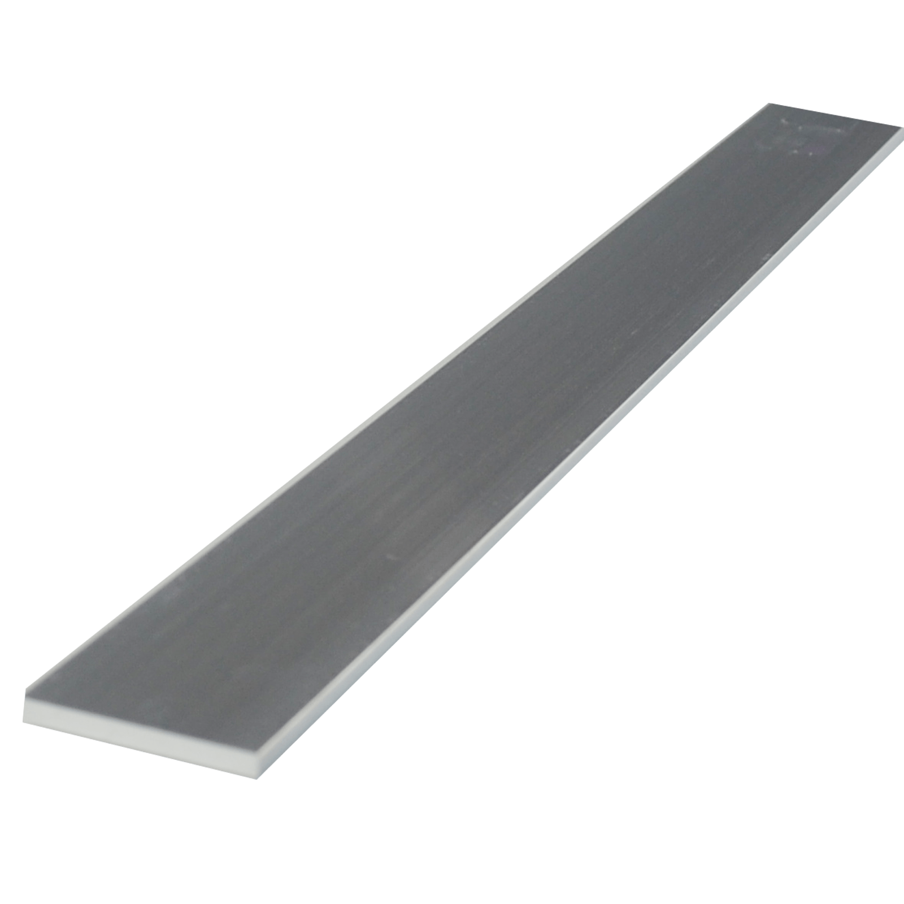
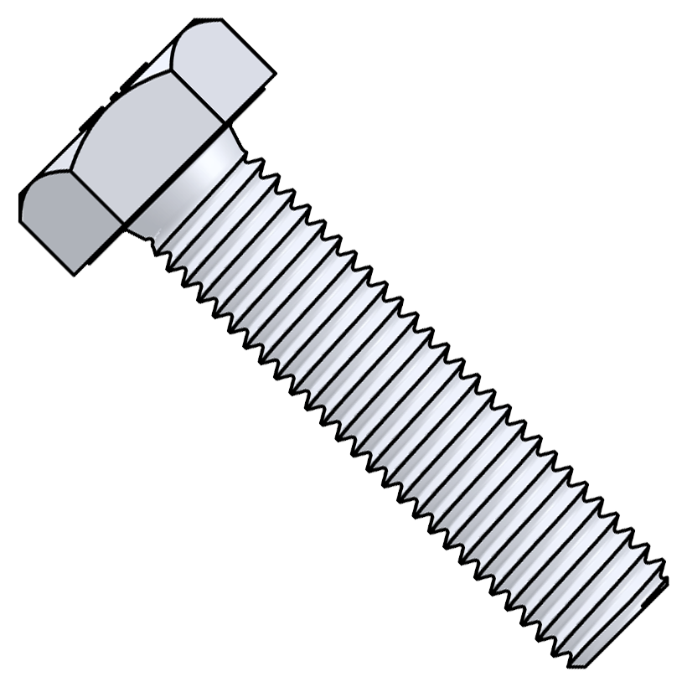
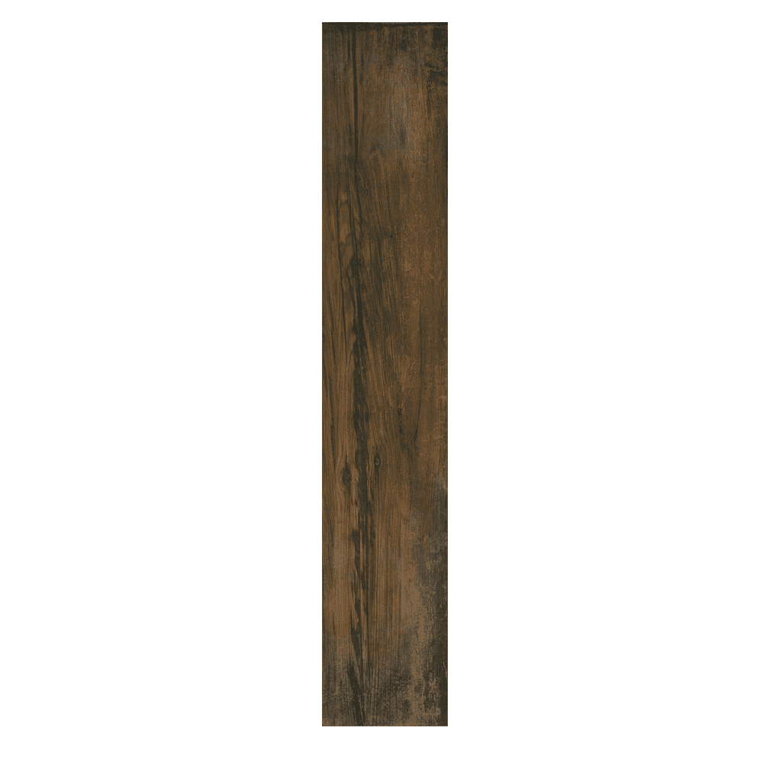
Outcomes
Aim to deliver:
  Discover which concept (moving UAV or stationary cameras) is more sufficient and efficient for FOD detection.
  Explore whether camera distortions caused by weather and environmental factors can still be analyzed to effectively identify FODs on runways.
Final product:
  By the end, the best UAV/Camera from all tested will undergo real-world testing on a runway, with different weather conditions and scenarios.
  This final test will undoubtably answer the research question stated at the beginning and deliver a final product.
  This product would be sufficient so that human verification is not needed before a crew is sent out.
FOD
FOD
FOD
[16]

Slide 7

Conclusion
This presentation has:
  Introduced FOD and object detection using AI
  Given reasons and explanations why this problem needs to be researched further.
  Presented methods to test different factors of the concepts proposed
  Indicated the number of resources required to undertake testing the concepts
  Predicted outcomes from testing the design concepts
In conclusion, this proposed design shall exceed the design concept before it and make air travel a safer experience.
[17]

Slide 8

Thank You for Listening
[18]

Slide 9
References
Qantas, “Airbus A380,” Qantas, [Online]. Available: https://www.qantas.com/au/en/about-us/our-company/fleet/qantas-a380.html. [Accessed 17 September 2024].
A. Green, “FOD- Foreign Object Debris/ Damage,” LinkedIn, 20 November 2019. [Online]. Available: https://www.linkedin.com/pulse/fod-foreign-object-debris-damage-andrew-green. [Accessed 18 September 2024].
L. Oz, “17 Interesting Applications of Object Detection for Businesses,” alwaysAI, 15 June 2022. [Online]. Available: https://alwaysai.co/blog/object-detection-for-businesses. [Accessed 17 September 2024].
INSIGHT SRI Ltd, “The Economic Cost of FOD to Airlines,” in INSIGHT SRI Ltd, London, UK, 2008.
T. Sato, “File:Concorde Air France Flight 4590 fire on runway.jpg,” Wikipedia, 25 July 2000. [Online]. Available: https://en.wikipedia.org/wiki/File:Concorde_Air_France_Flight_4590_fire_on_runway.jpg. [Accessed 18 September 2024].
M. Sinyi, Director, Air Crash Investigation Season 14, Episode 7: Concorde - Up in Flames. [Film]. USA: Cineflix, 2016.
Owatrol, “10 Essential tools your toolbox needs,” Owatrol, 29 September 2020. [Online]. Available: https://www.owatrolusa.com/decorating/essential-tools-for-toolbox/. [Accessed 18 September 2024].
S. Georgilidakis, “Singapore 747 FOD Update: Where Did It Happen?,” Mentour Pilot, 02 March 2021. [Online]. Available: https://mentourpilot.com/singapore-747-fod-update-where-did-it-happen/. [Accessed 19 September 2024].
E. Papadopoulos and F. Gonzalez, “UAV and AI Application for Runway Foreign,” in IEEE Aerospace Conference, Big Sky, Montana, USA, 2021.
A. Parker, F. Gonzalez and P. Trotter, “Live Detection of Foreign Object Debris on Runways,” in IEEE Aerospace Conference, Big Sky, Montana, USA, 2022.
Nomad, “Learn Microsoft Azure Basics in 5 Minutes,” Medium, 04 July 2023. [Online]. Available: https://medium.com/@nomadworld/learn-microsoft-azure-basics-in-5-minutes-29d8ead22202. [Accessed 19 September 2024].
DJI, “Camera Drones,” DJI, [Online]. Available: https://www.dji.com/au/camera-drones. [Accessed 19 September 2024].
DJI, “Phantom 4 Pro V2.0,” DJI, [Online]. Available: https://www.dji.com/au/phantom-4-pro-v2. [Accessed 20 September 2024].
AeroEXPO, “Airport Cameras,” AeroEXPO, [Online]. Available: https://www.aeroexpo.online/aeronautic-manufacturer/airport-camera-443.html. [Accessed 19 September 2024].
Adaptaive Recognition, “VIDAR ANPR/LPR Camera,” Adaptaive Recognition, [Online]. Available: https://adaptiverecognition.com/products/vidar-anpr-camera/. [Accessed 20 September 2024].
istock, “Aerial drone photo of air planes as seen from above docked in airport space stock photo,” istock, 23 November 2020. [Online]. Available: https://www.istockphoto.com/photo/aerial-drone-photo-of-air-planes-as-seen-from-above-docked-in-airport-space-gm1285519123-382330522. [Accessed 20 September 2024].
J. Durston, “Air New Zealand shows off stunning, all-black Dreamliner,” CNN, 09 July 2014. [Online]. Available: https://edition.cnn.com/travel/article/air-new-zealand-787-9-dreamliner/index.html. [Accessed 20 September 2024].
FODsigns, “FOD-poster-pickitup-style2-22×28,” FODsigns, 22 September 2014. [Online]. Available: https://fodsigns.wordpress.com/portfolio/fod-signage/fod-poster-pickitup-style2-22x28/. [Accessed 20 September 2024].

